Slide 1

Chapter 6: Fig 6.47 Linked Lists

Slide 2
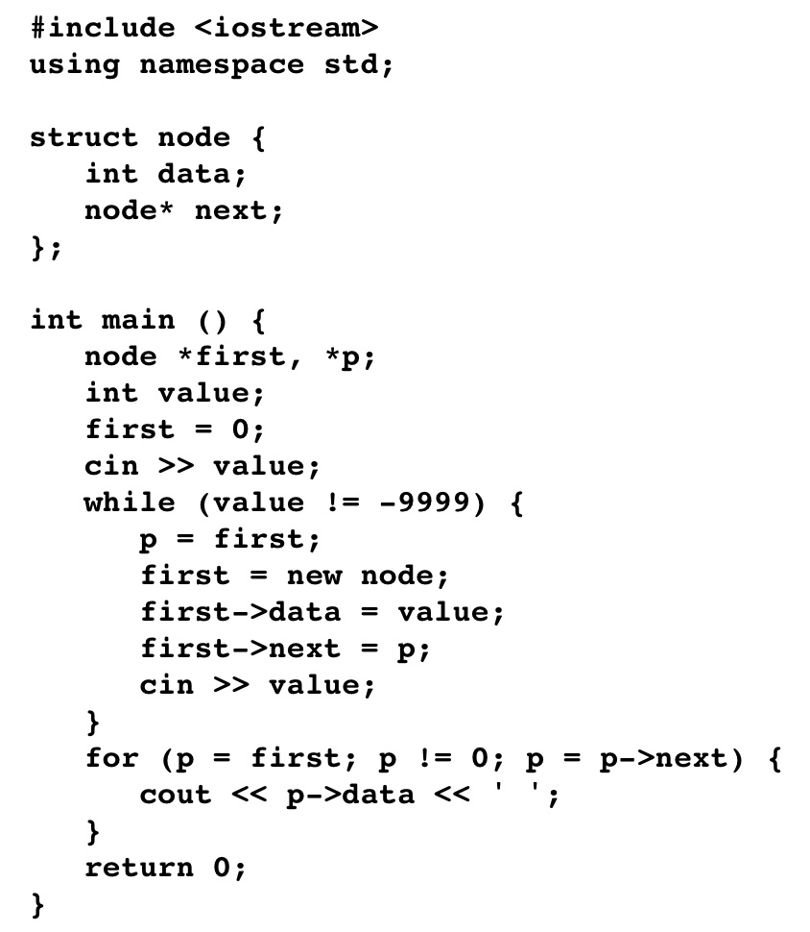
Linked Lists fig. 6.47

Slide 3
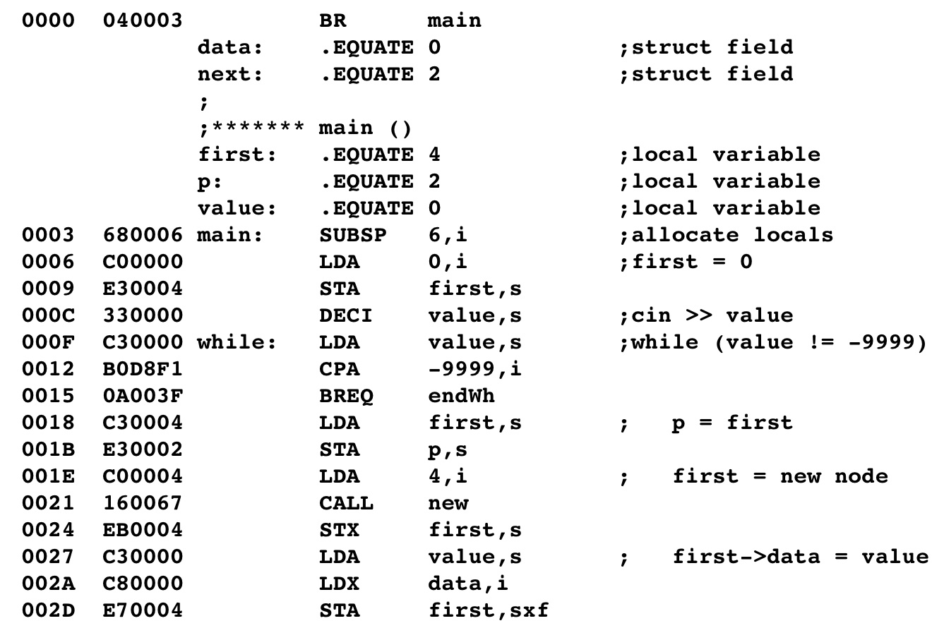
Linked Lists

Slide 4
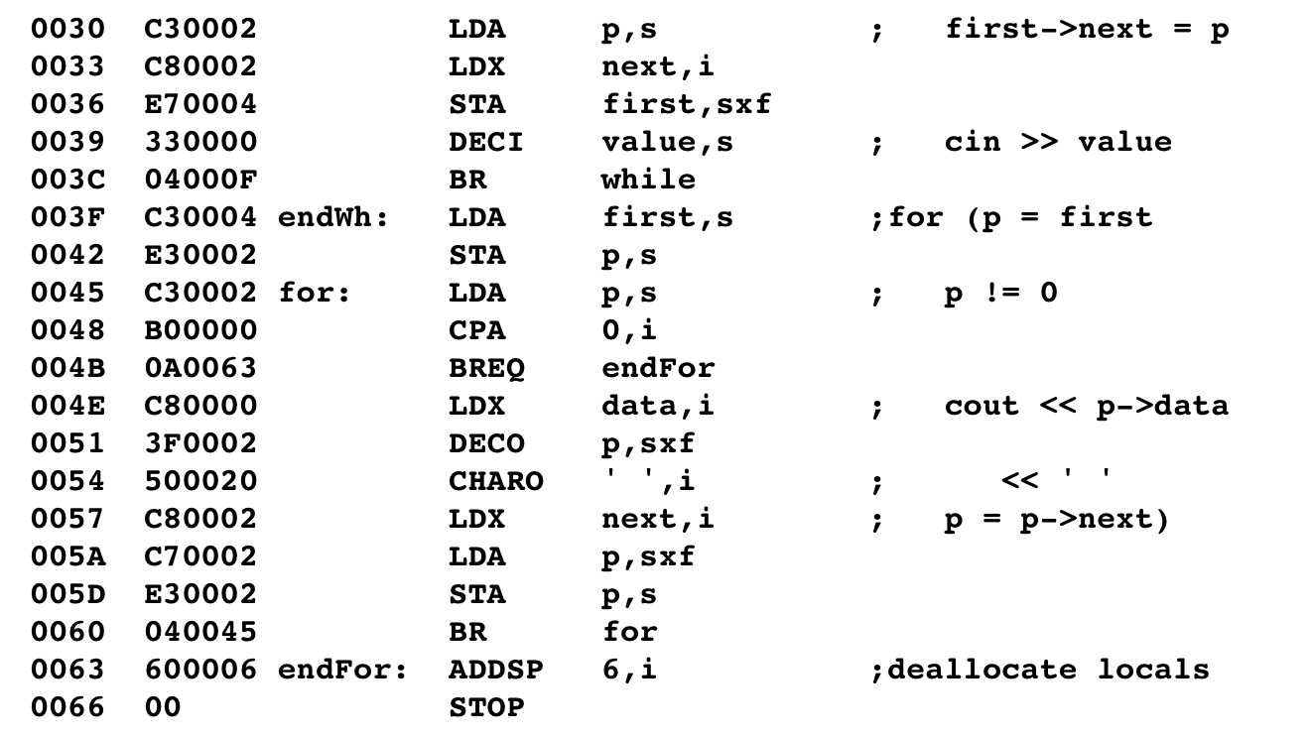
Linked Lists

Slide 5
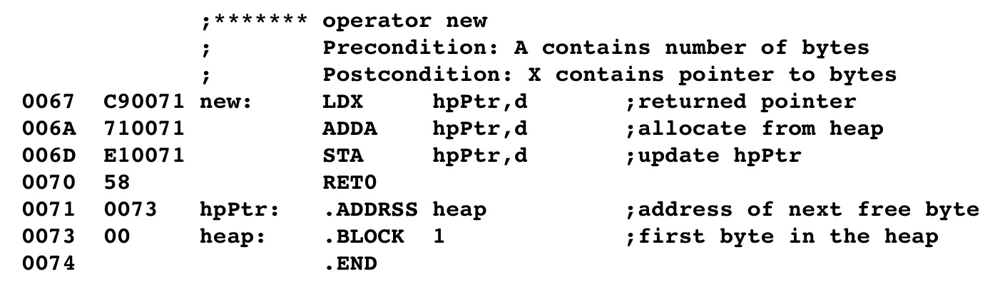
Linked Lists

Slide 6
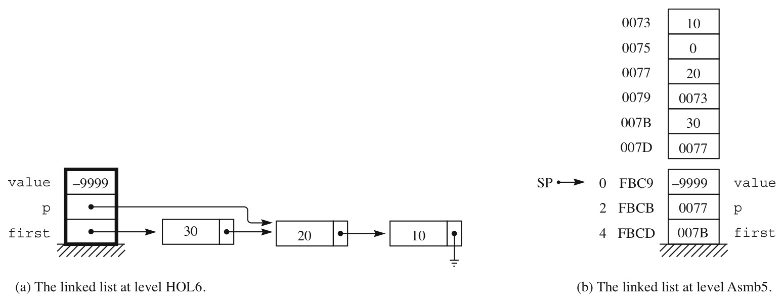
Linked Lists

